Slide 1
Fujitsu World Tour 2015
&
Fujitsu Innovation Gathering

Slide 2
La innovación como motor de futuro: Preservando nuestro entorno Plataformas digitales de conocimiento
Jesús Marco de Lucas, investigador
Consejo Superior de Investigaciones Científicas (CSIC)
Instituto de Física de Cantabria (IFCA)
Centro Mixto CSIC-Universidad de Cantabria

Slide 3
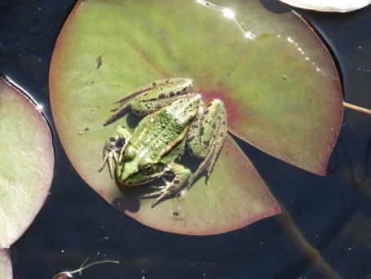
An example: Water Quality in our Planet
We use our best knowledge to preserve rivers, lakes, oceans
Management of resources, reduce pollution, enforcement of directives
Surprisingly (?), what is the best indicator for Water Quality?
If we look in detail, this is a very complex problem
Complex Factors: Global Warming , Anthropogenic Pressure
Complex Model, involving:
Different coupled sub-models (climatic, geo, hydro, bio, human impact)
At different scales (from the genes of the species under pressure, to the whole Earth)
But also we have now in our hands powerful tools:
Complex instrumentation providing all types of digital information in real time
Large computing resources to assist with models and support DECISION TAKING

Slide 4
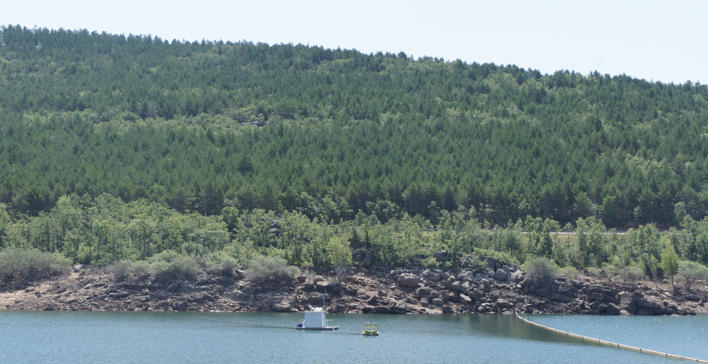
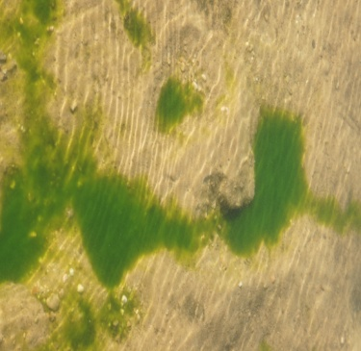
In detail: preserving water quality in a lake
As a clear example of innovation, in collaboration with an env-oriented SME (Ecohydros SL)
we have gone through the whole chain in a pilot project at a water reservoir (started in 2009)
Complex and powerful instrumentation
Measuring water quality indicators, including algae estimation at 3D
Whole simulation suite (hydrological, ecological, human impact)
Exploiting many different sources of digital information (maps, statistics)
Only some of them available as Open Data
Running on HPC Cloud resources (EGI FedCloud) using EU open middleware (DORII, INDIGO)
Validated against real data
Analyzing Big Data outputs (3D maps of many variables) in almost real time to understand correlations
Now the SME can test and propose new management solutions to better preserve the water quality
The SME is already extending this experience to other water reservoirs
And now we plan to extend the experience to Sanabria lake
And incorporate new sources of digital information: SENTINEL-2 satellite maps
But this is just an example of what can be setup under a global approach…

Slide 5
what we have and what we need
LifeWatch ( lifewatch.eu ) is an ESFRI for Biodiversity and Ecosystem Research
Sevilla/Andalucia will host LifeWatch statutory seat and e-infrastructure coordination
LifeWatch is well connected at international level
Examples: GBIF, LTER, COOPEUS, EU-Brazil OpenBio, RDA
What we have:
EGI LifeWatch Competence Center, integrating Observatories, Workflows and Citizen Science: Virtual Research Environments
A pilot e-Infrastructure integrating resources using INDIGO middleware in EGI FedCloud and instrumentation in Doñana natural reserve
What we miss:
Accessing (as e-services) (Open) Data is not enough,
Cloudifying workflows to process Data is not enough,
We need a way to describe and preserve the experience, the knowledge, of the researchers solving the problem!
We need Digital Knowledge Platforms!
Join us in COMSOTEC 2015
Sept 9-11 in Santander!
http://goo.gl/0utyCI

Slide 6
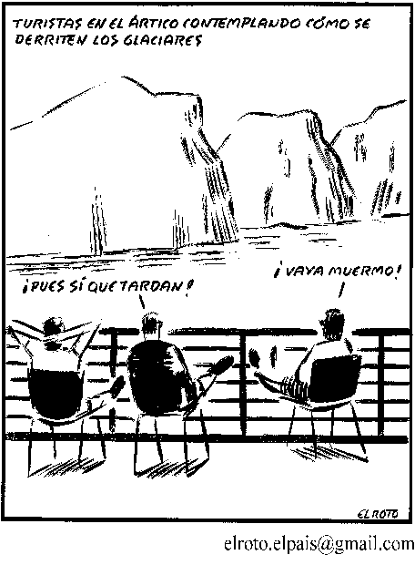
Can we wait to shape tomorrow?
See what collaborative work can do
https://vimeo.com/129554666

