Slide 1
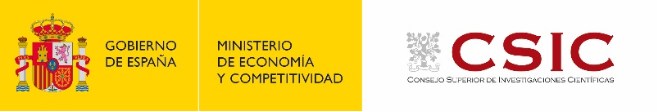
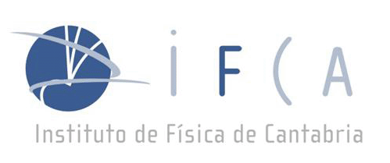




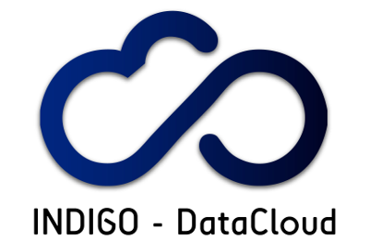
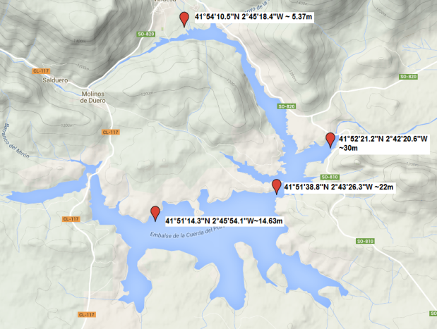
Relevant data and parameters for understanding and validating models and comparing observations about Water Reservoirs and Lakes, with specific emphasis on addressing Algae Bloom
Presented by A.Monteoliva (ECOHYDROS SL, Spain)
J.Marco, F.Aguilar (IFCA, CSIC-UC)
@ Global Water Information IG,
7th RDA plenary, 1st March 2016, Tokyo

Slide 2
Introducing our collaboration on Water Reservoirs
IFCA = basic research center (CSIC=National Research Council in Spain, + University of Cantabria), Advanced Computing & e-Science group
ECOHYDROS SL = SME on Advanced Water Ecology
2005: Start of IFCA-ECOHYDROS (SME) collaboration
  Modeling for Itoiz water reservoir, CWM models (ELCOM, DYRESM+ CAEDYM)
  Modelling of A Watershed: A Distributed Parallel Application in a Grid Framework
2008: DORII EU FP7 project
  Monitoring platform @CdP, Instrumentation, Labview, Web Services, Grid Instrumentation
2012: ROEM+ (LIFE+ project)
  Extension of monitoring system
  Start of use of Delft3D for hydrological and water quality (algae bloom)
2013: Connecting with LifeWatch (EU ESFRI) initiative
  Presentation to EGI.eu
  SCARCE Int.Conference, NETLAKE
2014: Extension of monitoring network
  Cogotas water reservoir: new monitoring station connected via 3G
2015: Case Studies for EGI LW Competence Center and INDIGO-DataCloud
2016: New initiative at Sanabria (alpin) Lake in Spain

Slide 3
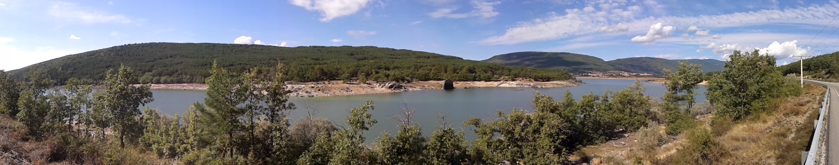
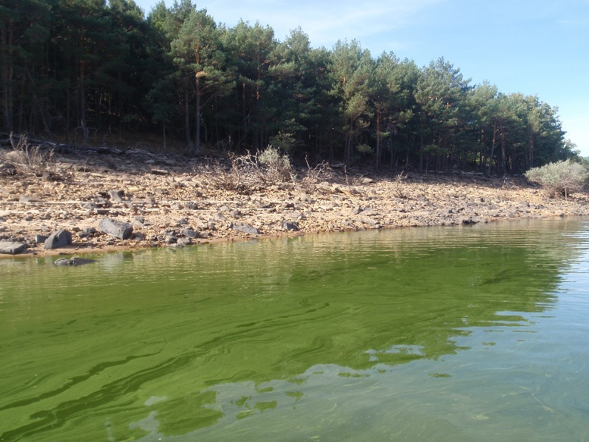
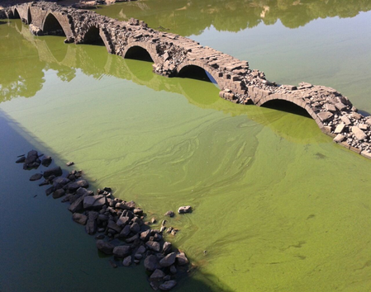
Disertación de Agustín Pedro Monteoliva Herreras para optar al grado de Doctor
Tesis dirigida por el Prof. Dr.
Juan Carlos Canteras Jordana
Aproximación basada en Ciberinfraestructuras Remotas y Modelado para Mejorar la Gestión de la Eutrofización en Lagos y Embalses

Slide 4
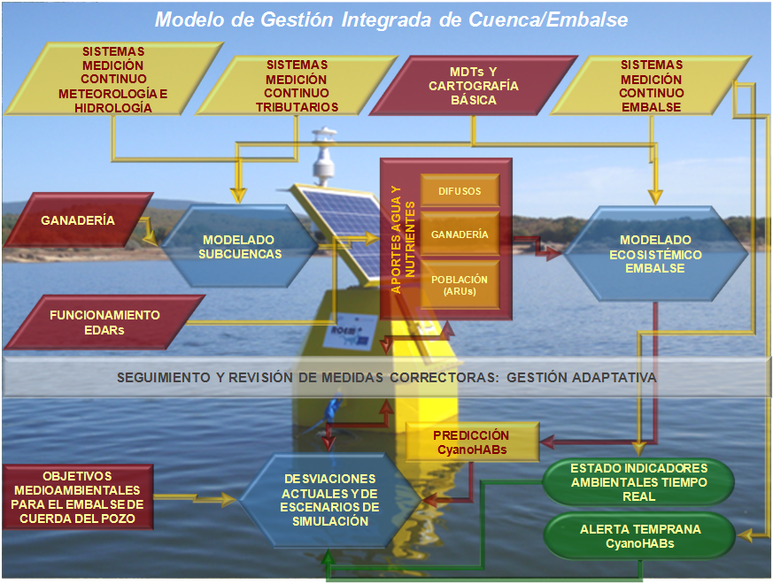
Planteamiento general

Slide 5
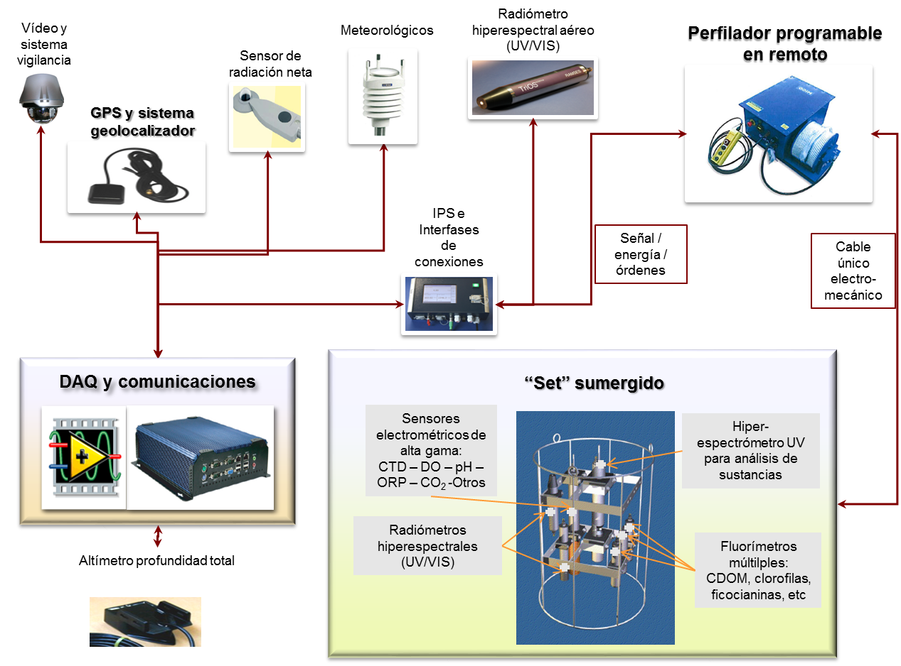
Estación perfiladora central

Slide 6
Modelo 3D: Biogeoquímico
Delft3d-ECO (Smits et al., 2013). Se acopla dinámica al Delft-FLOW. Integración numérica de ecuaciones de conservación de la masa. Resuelve ecuaciones 3D de advección, difusión y reacción, en malla computacional de volúmenes finitos:
Módulos aplicados en Cuerda del Pozo:
Crecimiento, mortalidad del fitoplancton
Extinción de la luz
Descomposición de la materia orgánica
Nitrificación, desnitrificación
Adsorción y precipitación de fosfato
Disolución del silicato opal
Reaireación del oxígeno disuelto
Sedimentación neta de componentes particulados (sin resuspensión)

Slide 7
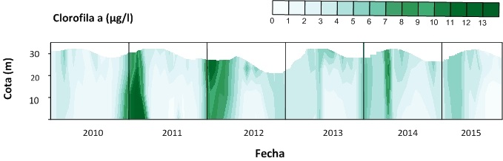
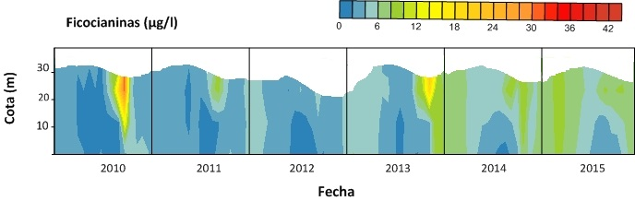
Plataforma perfiladora (II)
Clorofila a (biomasa de fitoplancton): Desarrollos clorofíceas invernales (2011 y 2012) y diatomeas primaverales (2014)
Ficocianinas (biomasa de cianobacterias): cHABs en 2010 y 2013, siempre en septiembre-octubre

Slide 8
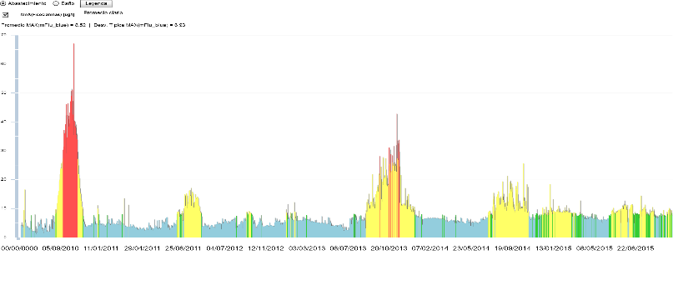
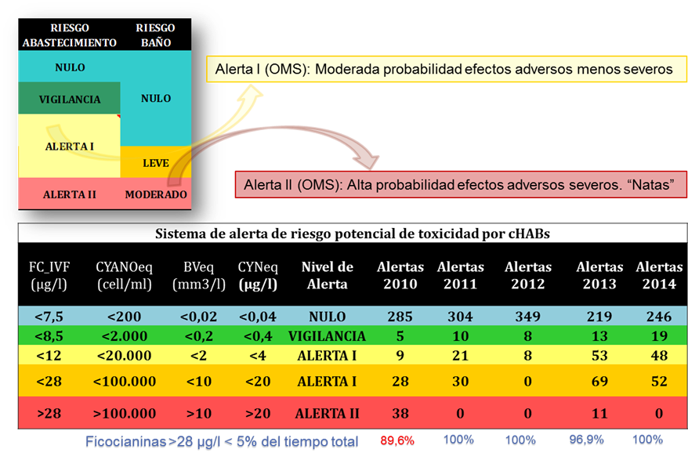
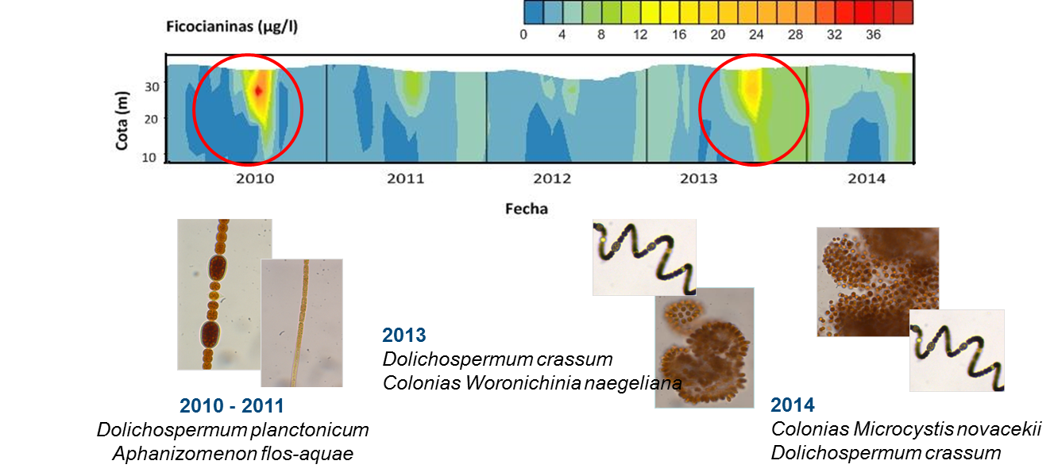
Sistema de alerta riesgo de cHAB

Slide 9
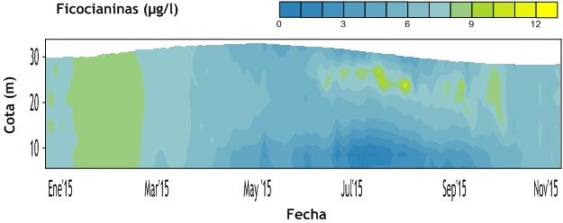
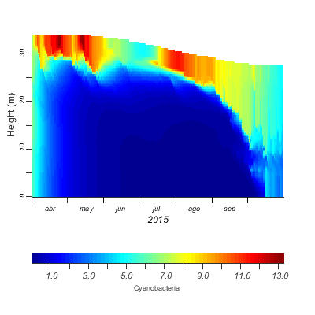
Modelo CAEDYM: Cianobacterias
Se muestra útil para predecir riesgo de cHAB generalizado en el embalse

Slide 10
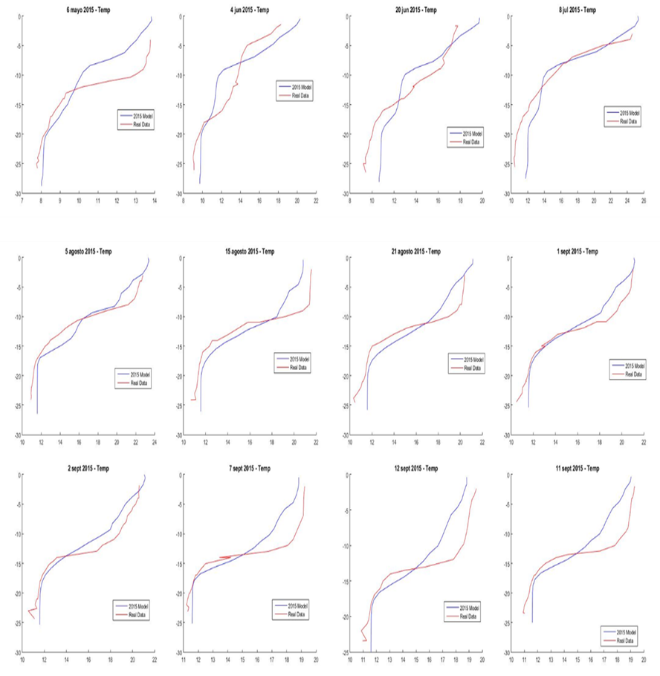
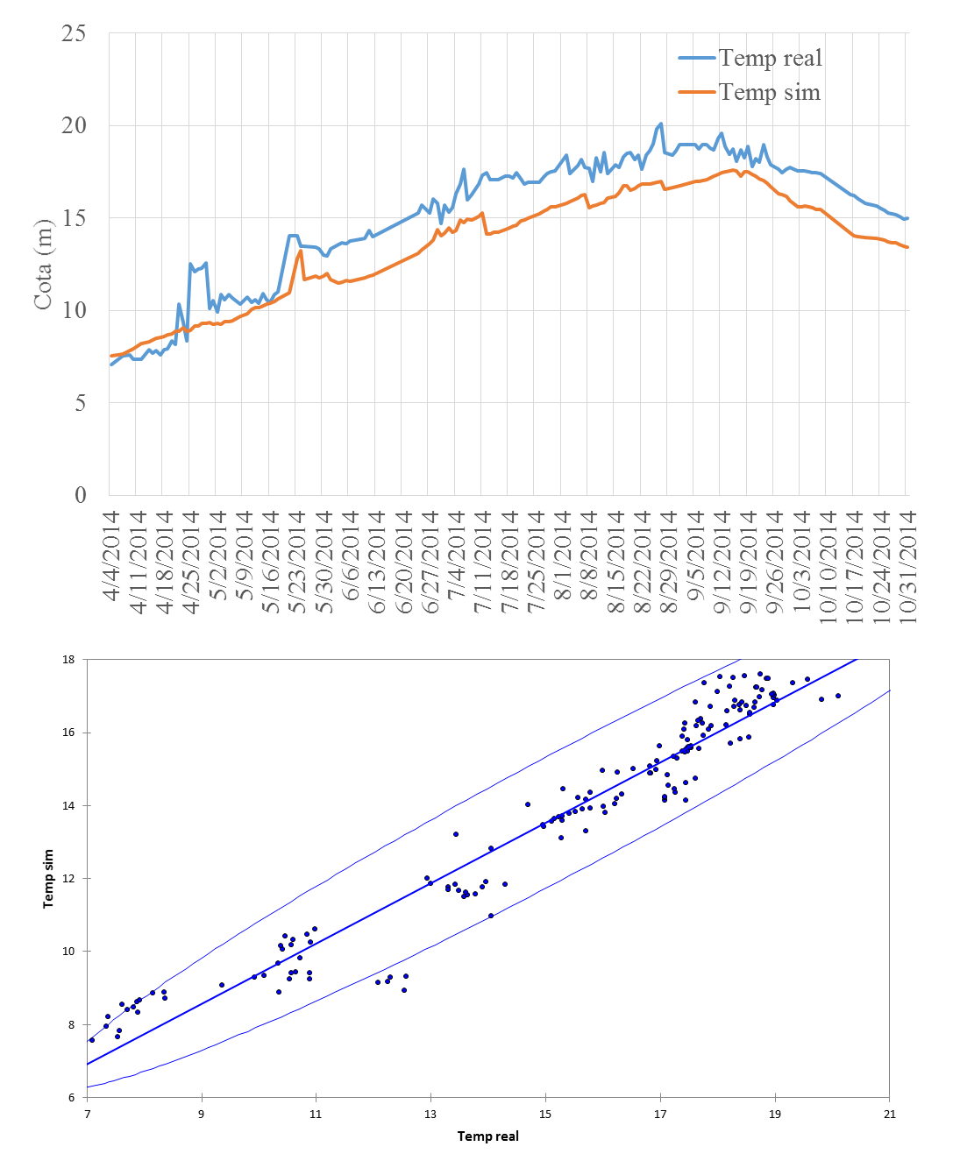
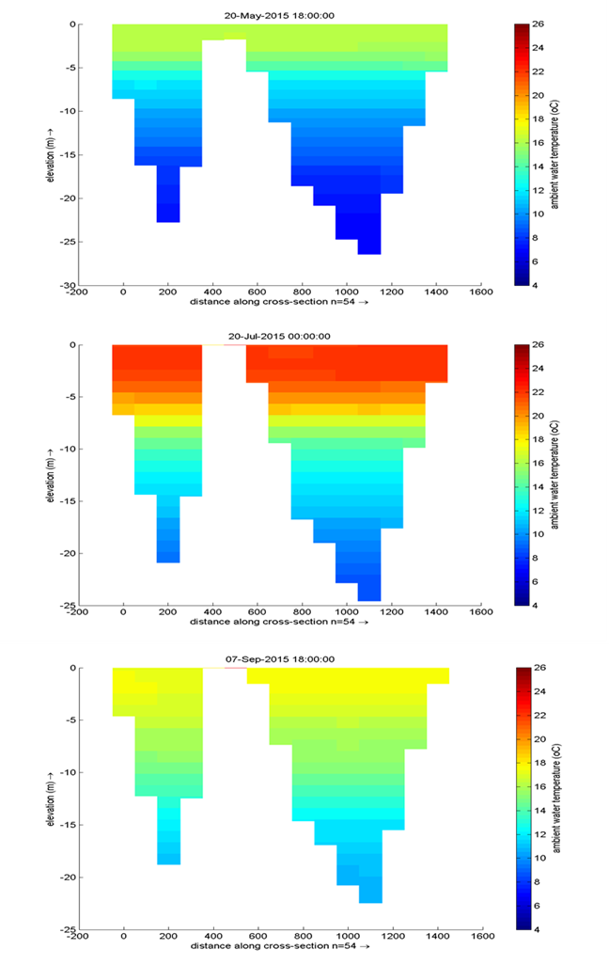
Modelo 3D: Hidrodinámica
Buen ajuste de la temperatura a lo largo del periodo de estratificación
Estructura vertical correctamente simulada

Slide 11
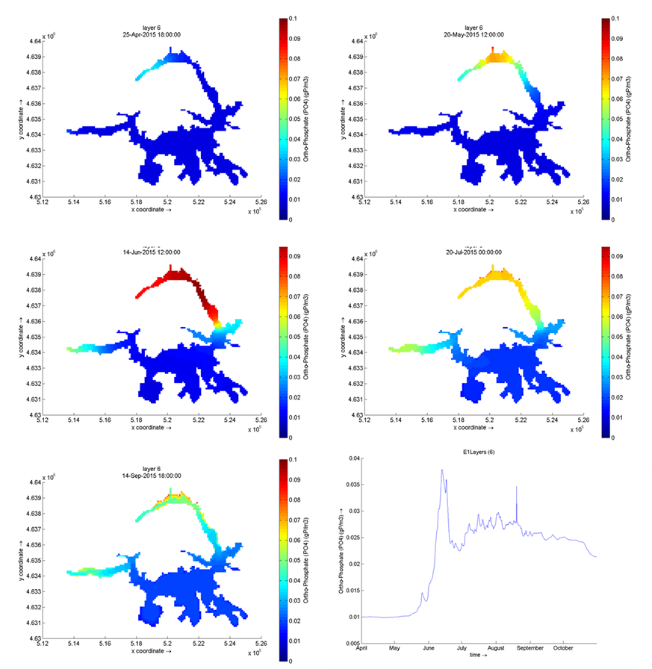
Modelo 3D: Calidad del agua
Traza bien el transporte y distribución de las sustancias.
Los rangos de concentraciones de nitratos son adecuados pero sobreestima los de fósforo.
No permite aún predecir cHABs de forma espacialmente distribuida (calibración futura con más datos en diferentes puntos de control).

Slide 12
FRAMEWORK
LifeWatch (lifewatch.eu) is an ESFRI (EU Research Infrastructure)
  Addressing Biodiversity & Ecosystems
  An e-Infrastructure to build Virtual Research Environments (VRE)
  Integrating OPEN DATA information
    GBIF, LTER, GENBANK, SATELLITE IMAGES, TERRESTRIAL MAPS...
EGI-LifeWatch Competence Center
  Framework: EGI FedCloud
  Dedicated Resources (~5000 cores + PB, new node in Seville, Andalusia, SPAIN )
Support LW VRE
  Marine VRE (marine.lifewatch.eu )
  Terrestrial + FreshWater VRE
Pilot projects
  Ecological Observatories Data Flow and “Big Data” analysis
  Workflows: Galaxy and TRUFA; Network of Life
  Citizen Science: Assisted Pattern Recognition

Slide 13
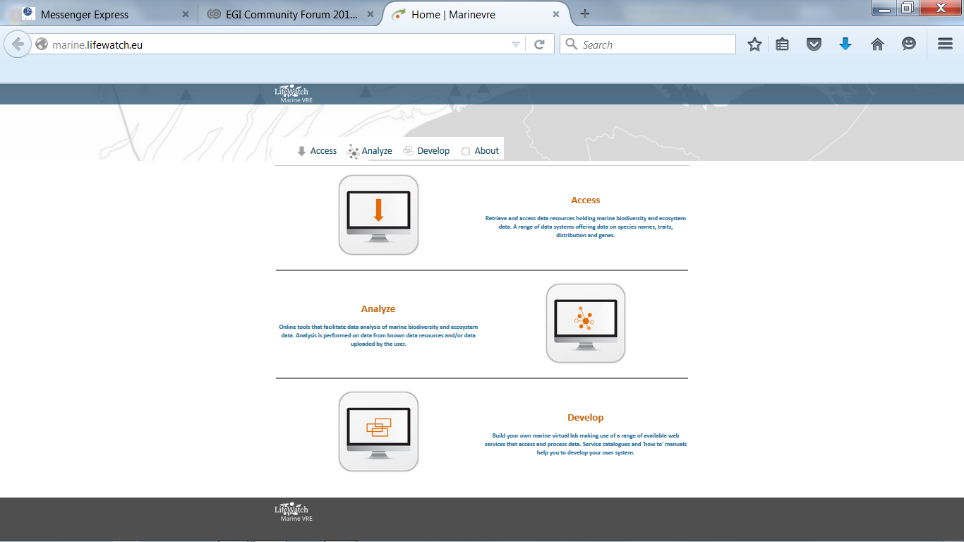
Exploration of VREs in LW
LifeWatch Marine VRE
Terrestrial-Fresh Water VRE
  Both SWIRL and CdP are included
Invasive Species VRE
See LW EGI CC session
@ Lisbon
See LW EGI CC session
@ BARI (TOMORROW!)

Slide 14
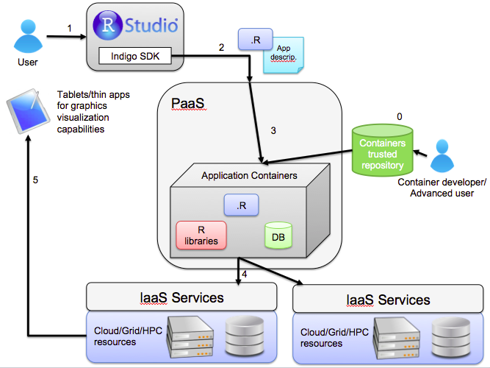
Global Scheme
USER APPLICATIONS
Portals
Visualization
Liferay
Platform for Collaborative Framework
Software as a Service (SaaS)
Open Data & Preservation Platform
Workflows
Kepler, Taverna
Distributed Control Platform
COMPOSITION
Platform as a Service (PaaS)
Orchestration
(ESB/BPL)
Orchestra
SOA/ Cloud Computing
e-INFRASTRUCTURE
Infrastructure as a Service (IaaS)
(Integration in EGI FedCloud)
RESOURCES
SITE
SITE
…
“External”
Data
“Internal”
Data
Network
Storage
Servers

Slide 15
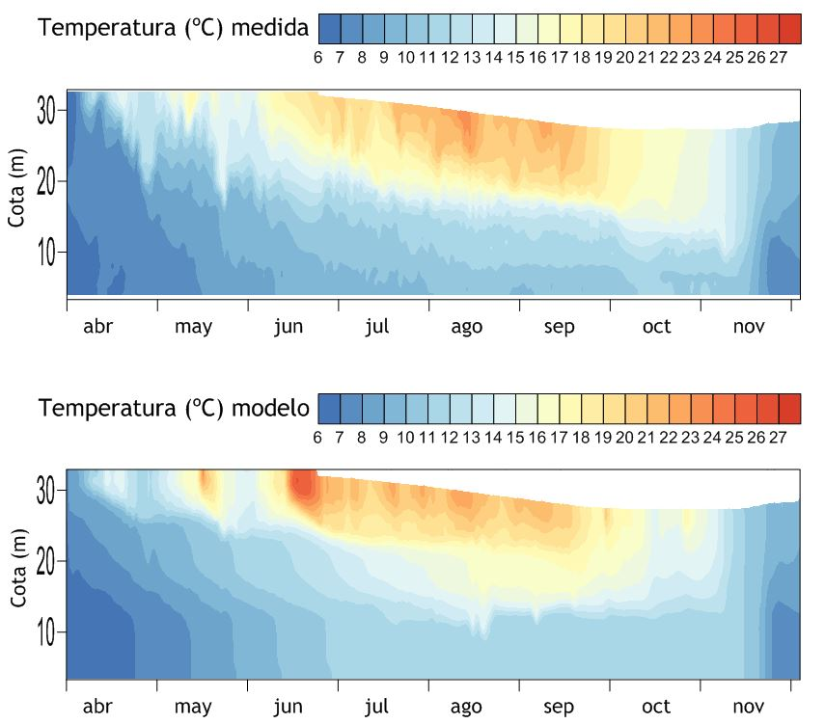
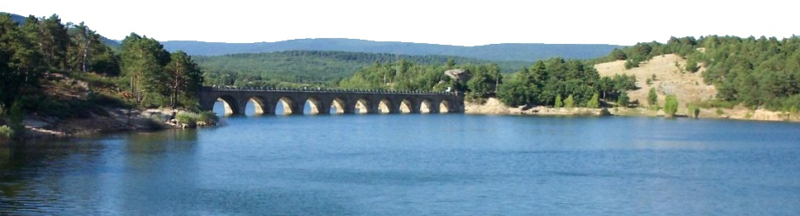
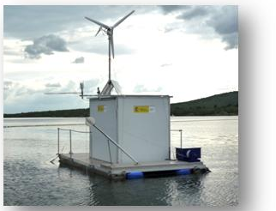
EGI-LIFEWATCH / INDIGO-WP2 Case Study
Monitoring & Modeling ALGAE BLOOM in a Water Reservoir
LIFE+ Project lead by a SME, collecting monitoring data (environmental station+ water quality and chloro-cyano profiler), and modeling hydro+bio
  INTEGRATE EXISTING OPEN RESEARCH DATA
    USE METEO, TERRAIN, BATHIMETRY, LAND USE
    HYDROLOGICAL INPUT
  PRESERVE NEW OPEN RESEARCH DATA & ANALYSIS
    REMOTELY COLLECTED DATA INTO REPLICATED DB
    COMPLEX MODEL OUTPUTS
    MULTIPARAMETRIC ANALYSIS
STORAGE+COMPUTING
NEED HPC FOR DELFT-3D
Model already running in FedCloud
Adapt Multiparametric scan
Preserve Thermoclines analysis (in R)
An Innovative Fresh Water VRE for LifeWatch

Slide 16
SOLUTIONS EXPLORED
See OPEN DATA Commons session @ RDA
  Support external resources (data, tools): VRE
  Enable a “/lifewatch/home” for each researcher/each community, accessible with ID via a preservation portal
  Users will define the “openness” of their
    DATA (private/embargo/open/published-DOI)
    ANALYSIS (R/python, via github)
    WORKFLOWS at SaaS level (R,python)
  Support it with a global (federated) distributed storage
    OneData (Data Commons basic component)
  Integrated also with FedCloud computing resources
    We will rely on INDIGO project developments to optimize!
  Enforce DMP (Data Management Plan)
If it needs to be preserved => DMP & OPEN (after embargo)
An Innovative Fresh Water VRE for LifeWatch

Slide 17
AN INTEGRATING VRE FRAMEWORK
Based on the idea of a Digital Knowledge Platform as a Framework for Open Science
  Start from Data Life-Cycle
  Dual View: Data & Software
  Incorporate Digital Knowledge from start
  Integration of external resources
  Include Acquisition
  Incorporate Analysis
  &… Simplify Workflows
  Enable Publication of Datasets
Developed initially as a Open Data Preservation Portal
  Using Structural Funds Project for LW in Spain
  In collaboration with
    Aeonium
    Viavansis
    Adevice
    Telefonica
See DKP talk tomorrow in
“Data without boundaries” session (16h20)
See “Setting up a new FedCloud site in collaboration with the industry” talk Thursday in
“Community Cloud” session (15h35)

Slide 18
APPLIED TO CdP WATER RESERVOIR
Start from Data Life-Cycle
    - DMP for CdP (already in INDIGO), DMP Online Tool
Incorporate Digital Knowledge from start
    - Understand the use of “ontologies”
Dual View: Data & Software
Integration of external resources
  Other measurements, maps & GIS…
  Models Output (example: Delft3D, ABM based)
Include Acquisition
  Ex: replace LabView web services using pyVISA from Jupyter
  Directly store into cloud enabled workspace (OneData)
Incorporate Analysis
&… Simplify Workflows
  Jupyter/Python notebook Thermoclinae example
Enable Publication of Datasets
  Mint DoI

Slide 19
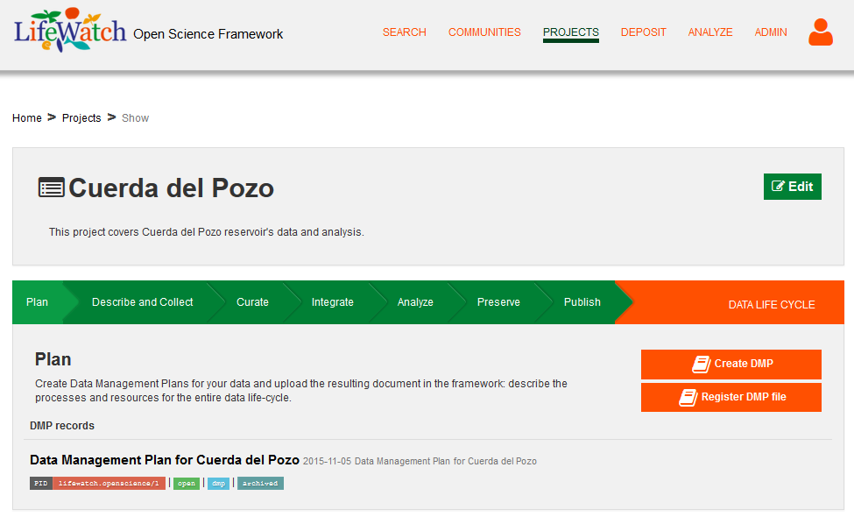
Projects follow the Data Life-Cycle: Plan

Slide 20
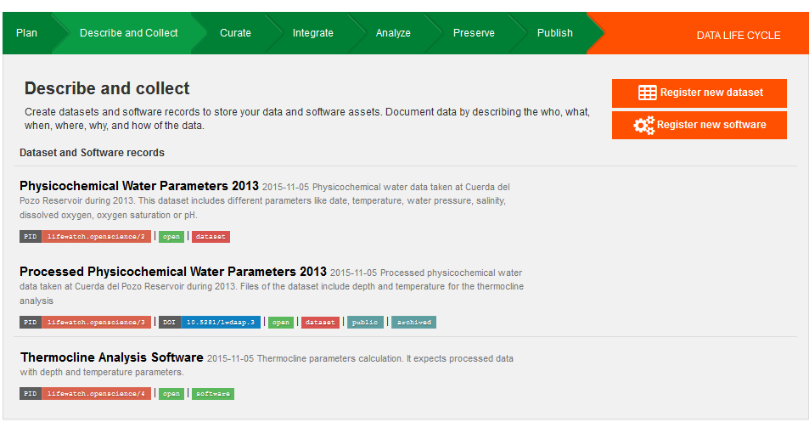
Projects follow the Data Life-Cycle: Describe

Slide 21
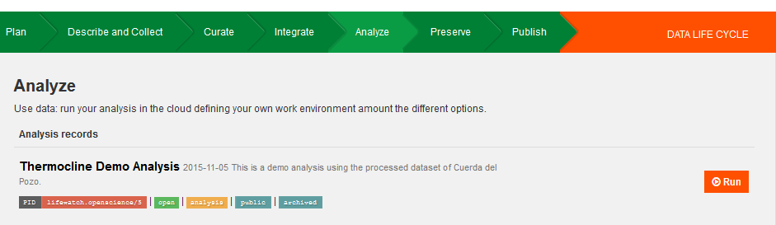
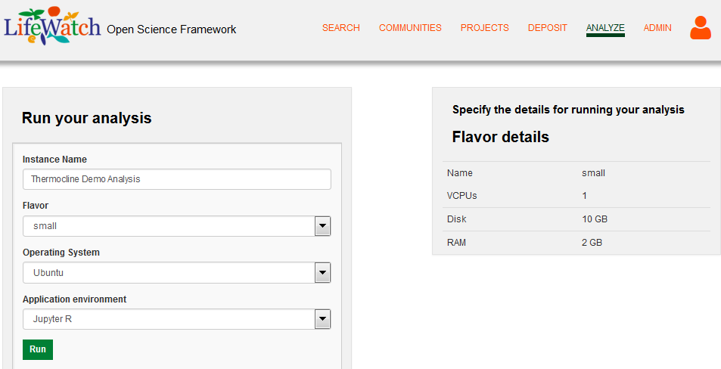
Projects follow the Data Life-Cycle: Analyze

Slide 22
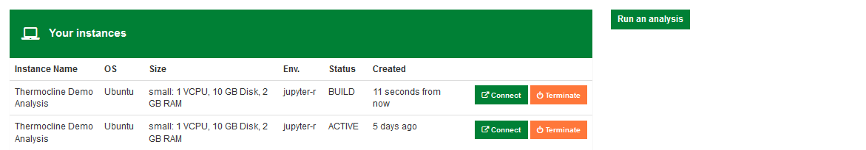
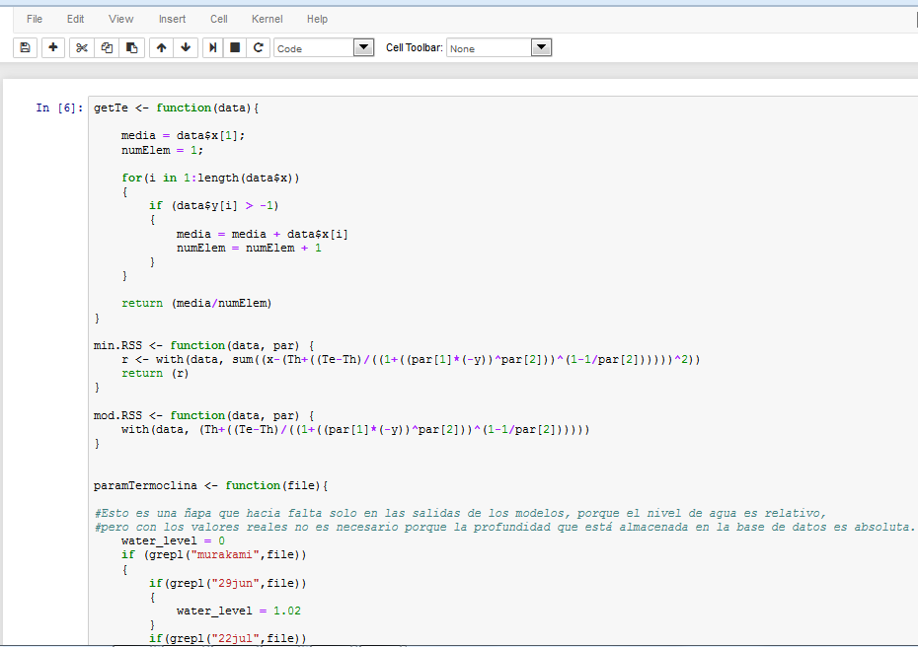
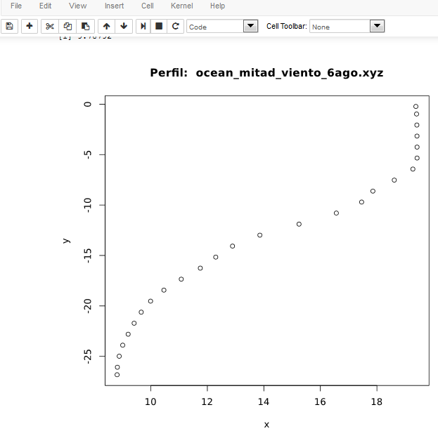
Projects follow the Data Life-Cycle: Analyze

Slide 23
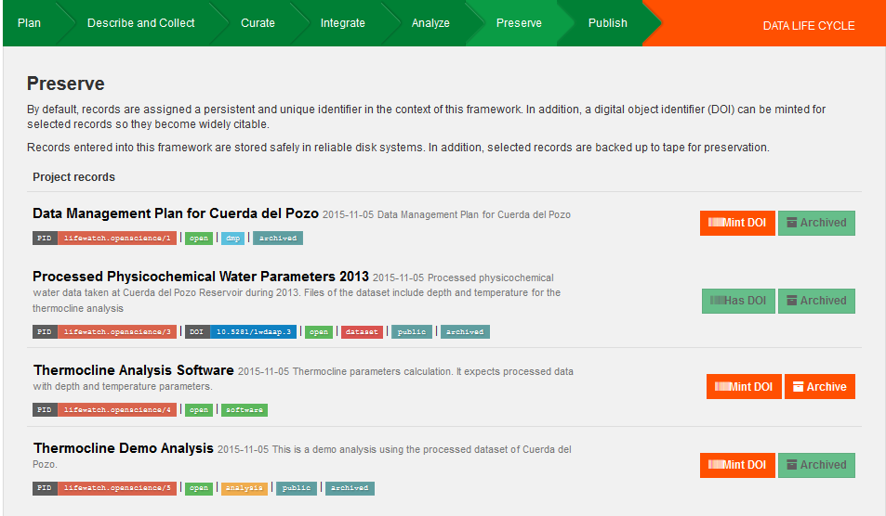
Projects follow the Data Life-Cycle: Preserve

Slide 24
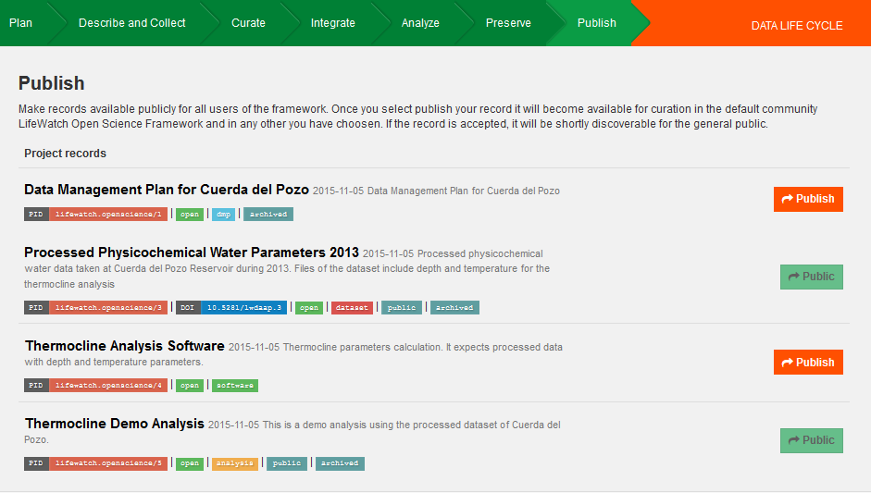
Projects follow the Data Life-Cycle: Publish

Slide 25
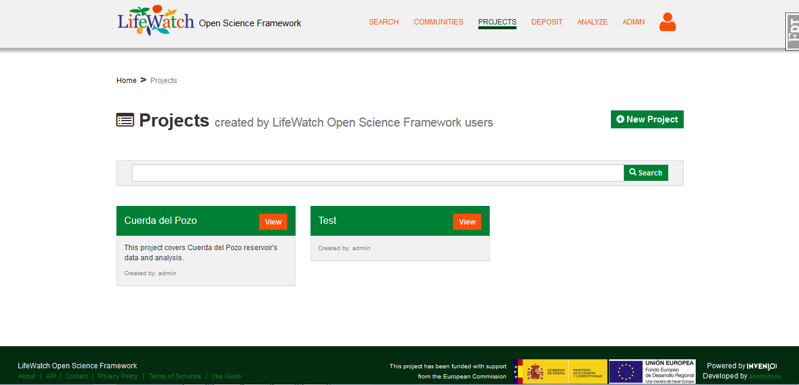
An integrating VRE oriented to Projects
Technical question: connect with OpenProject?
-code: github
-resources: VO policies, groups , VM…

Slide 26
Key question: Incorporate Digital Knowledge
Software (VM) + Data preservation is not enough
  Ideas explored under CMS preservation
    Validation
    Analysis Description
  CHEP 2014 discussion Knowledge Preservation
Incorporate Digital Knowledge from start
  Understand the use of “ontologies” / “semantics”
    Ontologies are not taxonomies
    Ontologies are not metadata
    Ontologies are not (restricted) vocabularies
Under analysis for Fresh Water VRE:
  Ontological Framework explored: SWEET
  Ontologies: EML and WaterEML
  Consider report at RDA 2015 (Paris) devoted session
  What about INSPIRE directive?
First try:
  Build on SWEET
  Start from vocabularies used in CdP
Yet, how to integrate into DMP? Ideal (unify) is obvious…

Slide 27
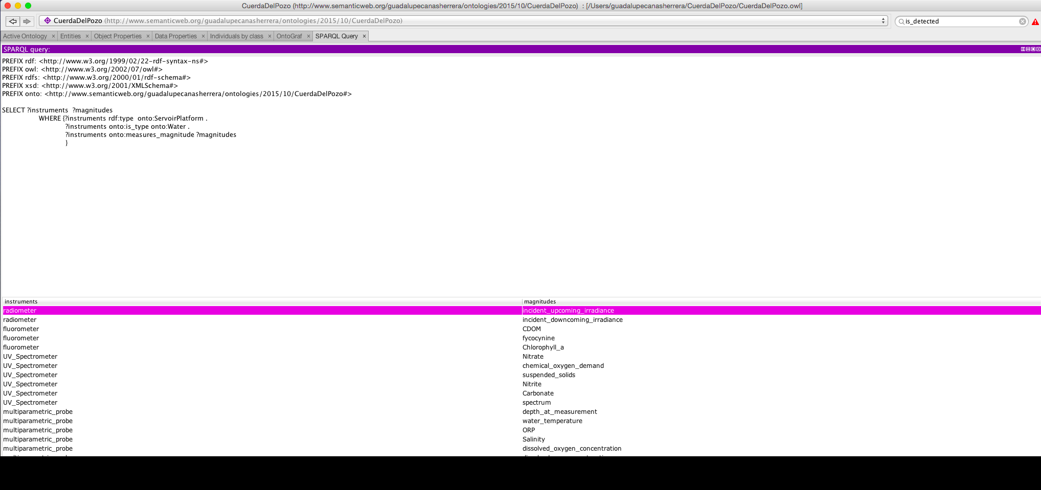
Incorporating Digital Knowledge…
OWL via PORTEGE
(to be integrated !!!)
BUT…
We NEED key questions
to understand what we can/want to do

Slide 28
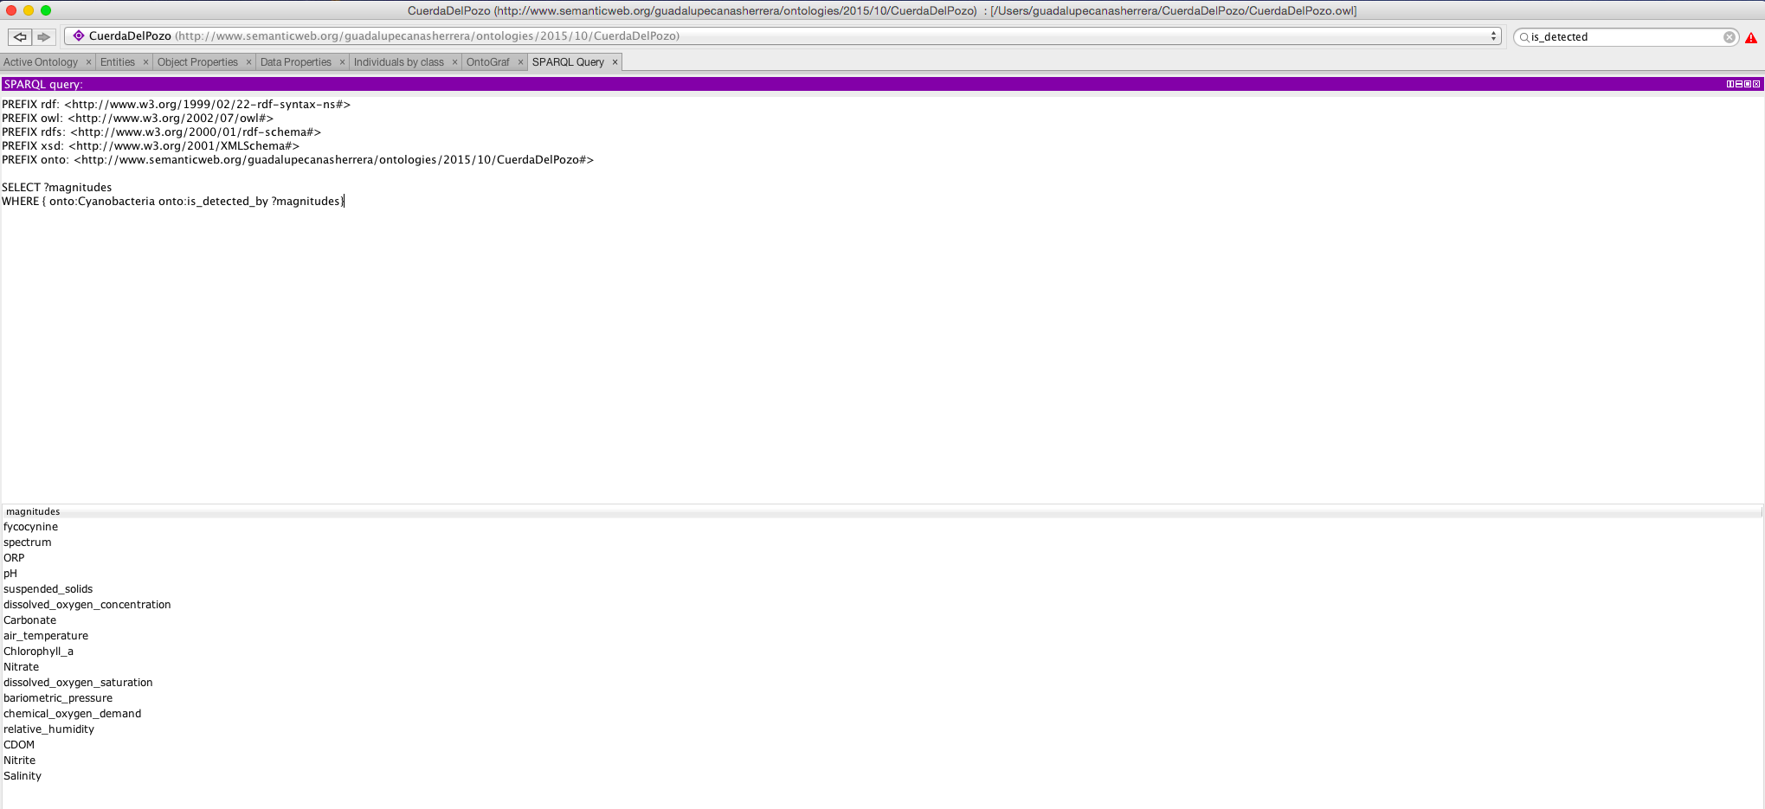
Incorporating Digital Knowledge…
SPARQL via PORTEGE
(to be integrated !!!)
BUT…
We NEED key questions
to understand what we can/want to do

Slide 29
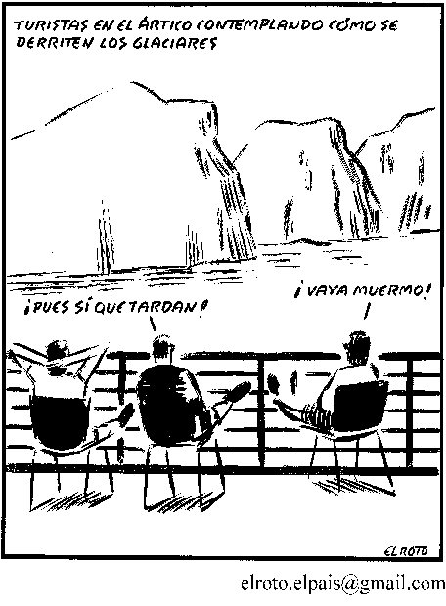
Tourists in the ARTIC seeing how glaciers melt
Join EGI-LW CC meeting in
EGI Conference in BARI
Tomorrow 11/11 @ 9h
It takes a while! How boring!

